Slide 1
SDT Navigator
David Dashevskii
Nikita Paniukhin
December 2024

Slide 2
What is this all about?
Goal: compute the best possible journey from A to B. What is “best”?
Multiple metrics (e. g. arrival time, number of trips, price etc.)
RAPTOR algorithm: Pareto-optimal journeys (cannot be improved on one metric without sacrificing another)
Possible application: find all Pareto-optimal journeys; filter out best ones using some cost function
For now, the only metric is arrival time.
Our problem: departure time is given. Find the earliest arrival time.

Slide 3

Demonstration
@SDT_Navigator_bot

Slide 4
Algorithm: RAPTOR
RAPTOR – Round-Based Public Transit Routing
Timetable = ( S, R, T, F )
S – set of stops
R – set of routes
T – set of trips
F – set of footpaths
Notes:
We present our project, SDT Navigator, a tool designed for efficient route planning in public transit networks. Our goal sounds simple: to compute the best possible journey. But what defines “best”? That’s a more complex question. It involves balancing multiple factors like travel time, number of transfers, and convenience of the overall trip.
We came across an inspiring research paper where the authors tackled this challenge using a novel approach. They described how to find Pareto-optimal journeys, meaning those that cannot be improved in one aspect (for example time) without worsening another (for example transfers).
Motivated by their work, we decided to replicate their approach and see if we could achieve similar results. In this presentation, we’ll explain how we implemented their ideas, adapted the methods to our needs, and what outcomes we achieved.

Slide 5
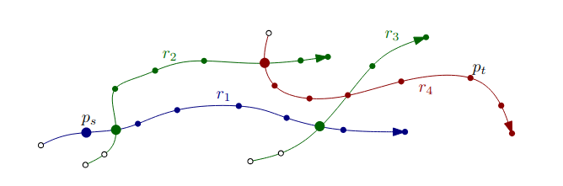
Algorithm: RAPTOR
Rounds; Kth round: journeys with ≤K trips
Relax along routes – maintain earliest trip we can board
Relax footpaths – like Ford-Bellman
Heuristics

Slide 6
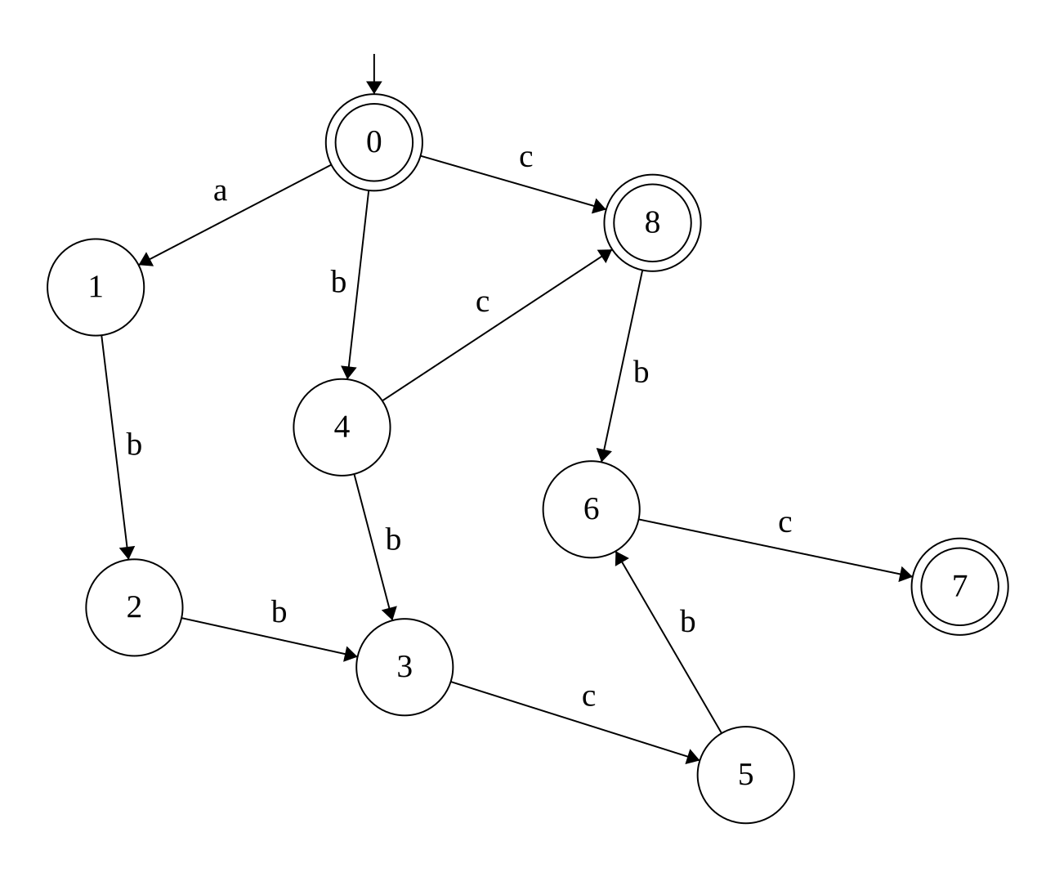
Algorithm: Suffix automaton
Want: given string T, find all stop names containing T
Suffix automaton of S - only accepts suffixes of S
Solution: A = merged SA of all stop names
Accept T in A, find all reachable terminal states

Slide 7
Data collection
GTFS – General Transit Feed Specification Developed by Google, embraced by transit systems worldwide
Public databases for public transit:
Google Transit
gtfs.org
mobilitydatabase.org
openmobilitydata.org
and more…
What we took from it:
Extended GTFS Specification
GTFS Specification
Old GTFS feeds

Slide 8


Architecture
Telegram bot
executable
Executable (CLI)
Tests
Algorithm
D
A
T
A
(CSV)
C++ structures
Data processing
JSON
Data loader

Slide 9
Testing
RAPTOR
Unit tests: specific routes
Property-based: “Triangle inequality”
Suffix automaton
Unit tests: simple cases
Stress tests: random set of strings, compare with naive solution
CLI, Telegram bot
No tests yet

Slide 10
Questions?

